Slide 1

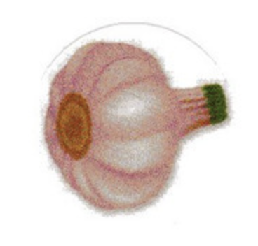
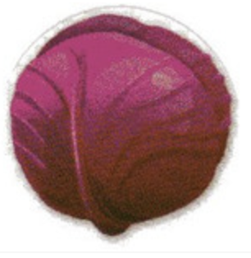



fruits
vegetables
almonds

Slide 2
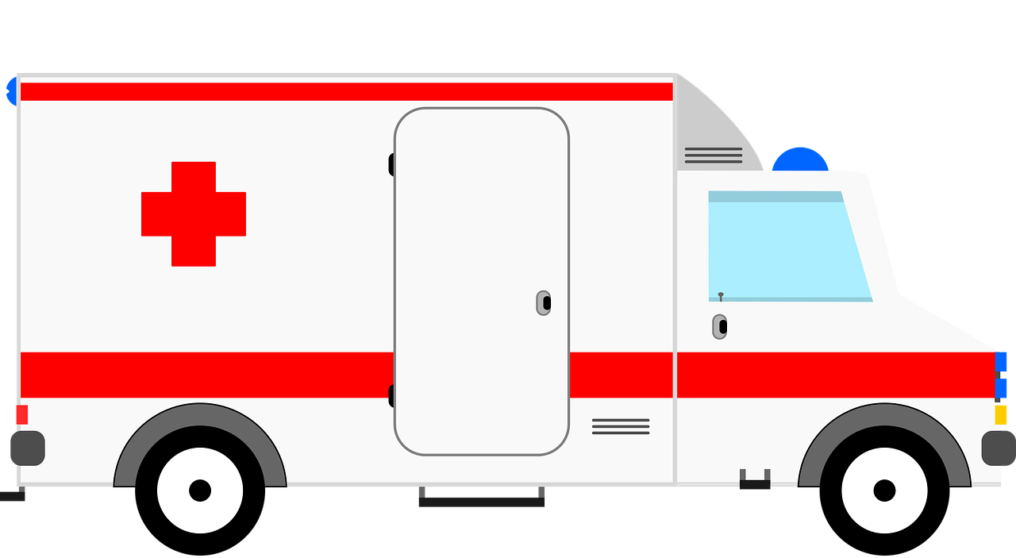
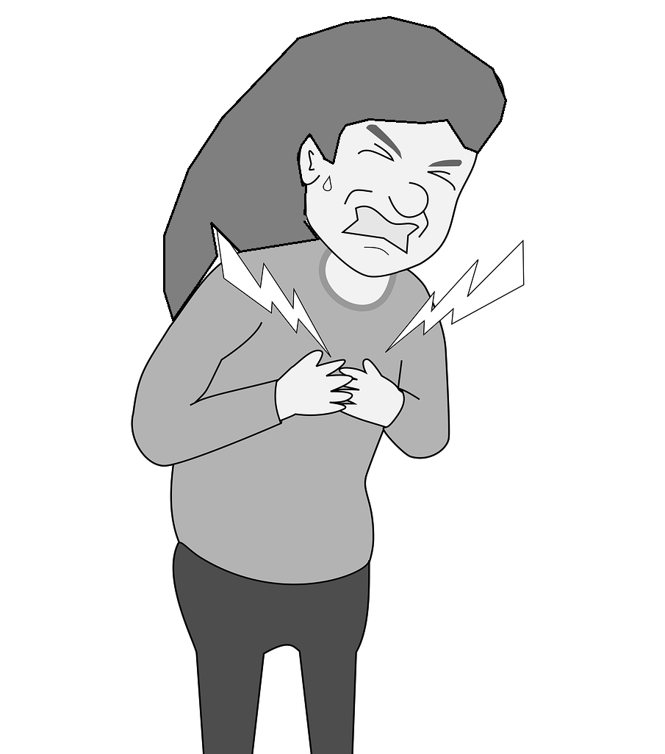
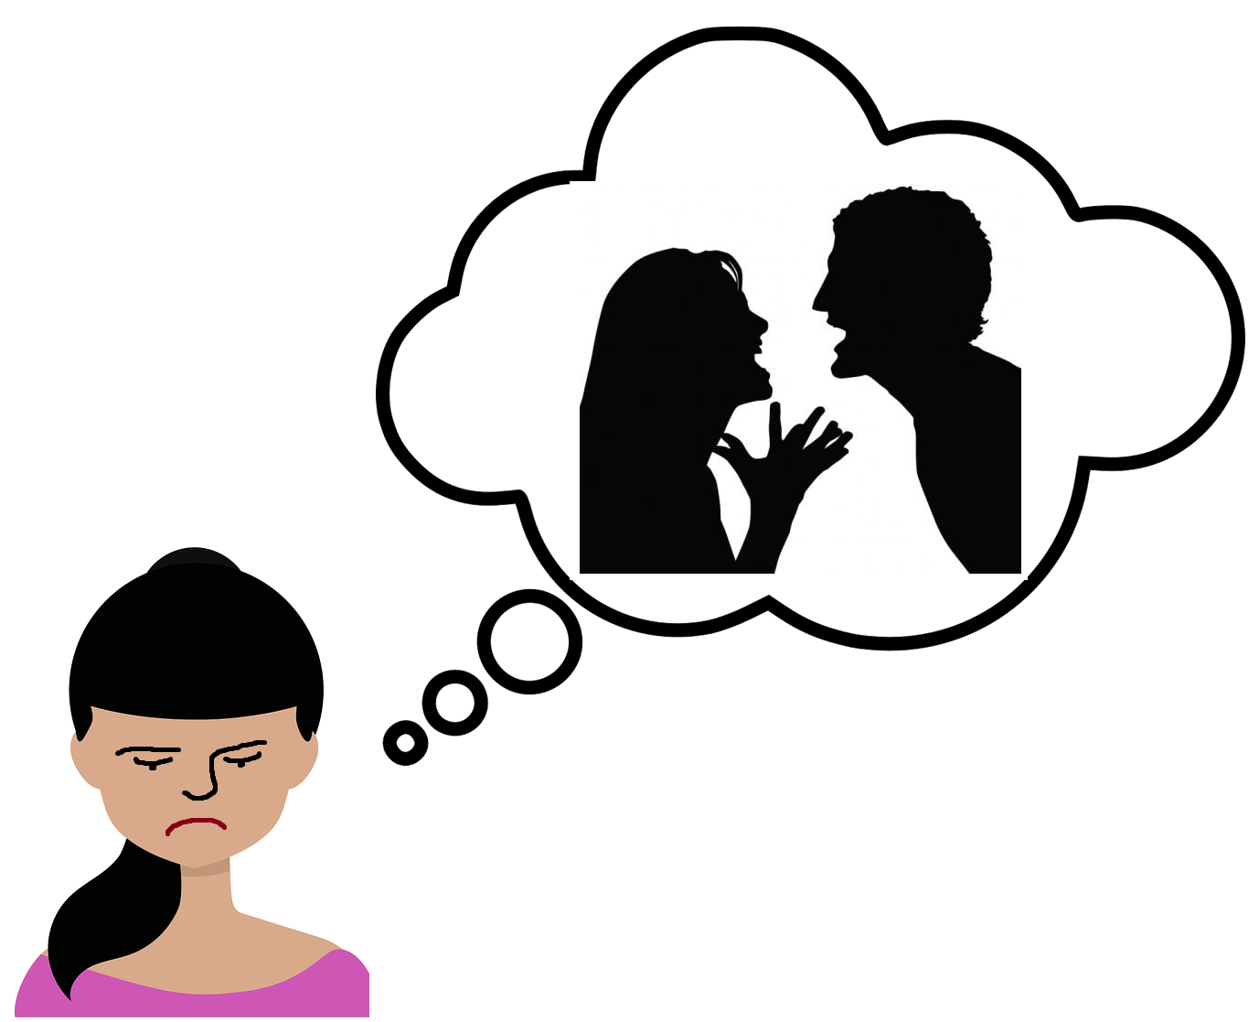
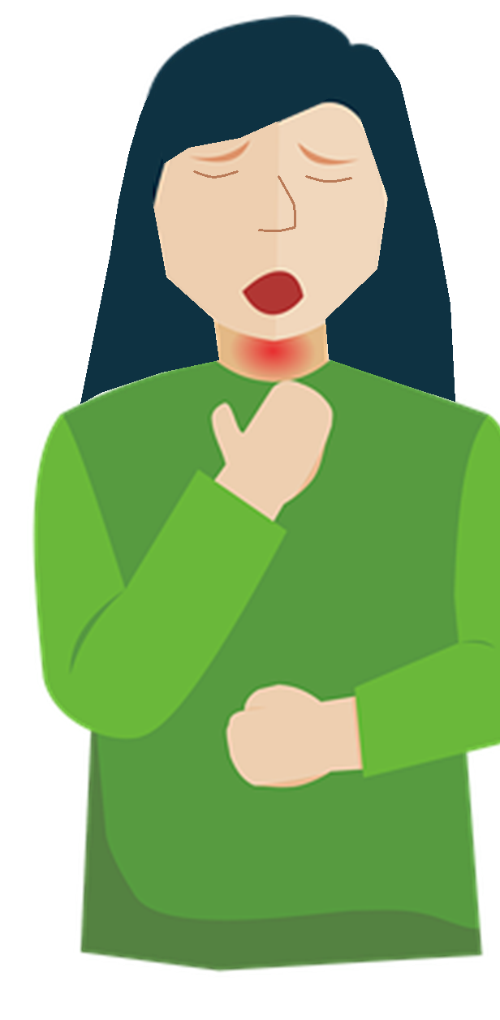
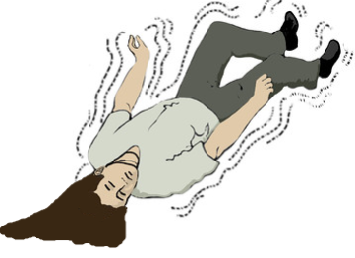
Go to emergency TODAY if you have any of these symptoms
Violent Thoughts
Cheat Pain
Trouble Breathing
Seizures

Slide 3
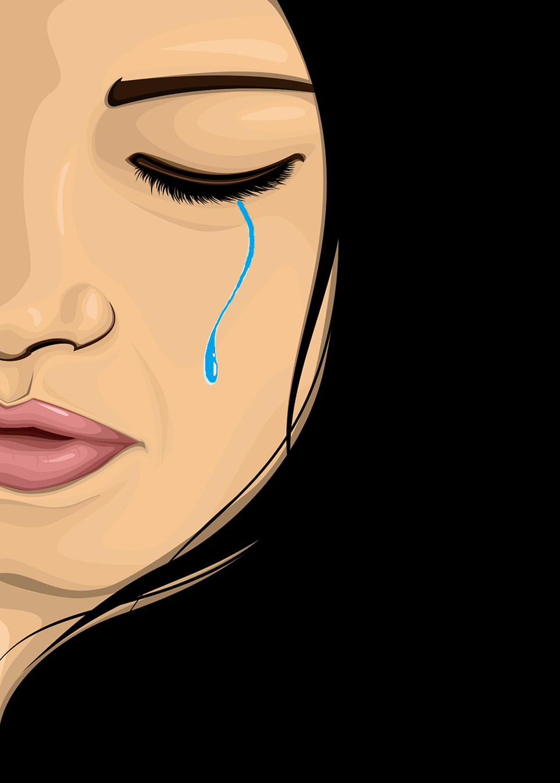
Go to emergency TODAY if you have any of these symptoms postpartum
Trouble Breathing
You have unusual thoughts about hurting yourself or your baby. You might not feel like yourself.
This could be a sign of
post-partum depression

Slide 4
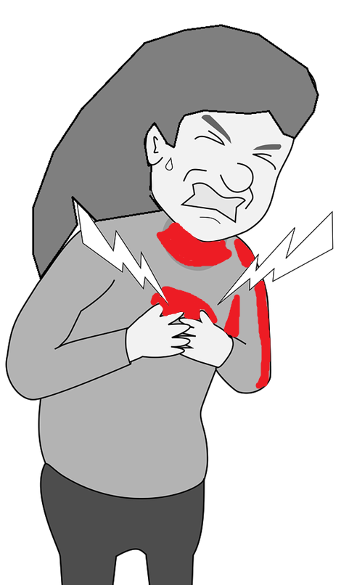
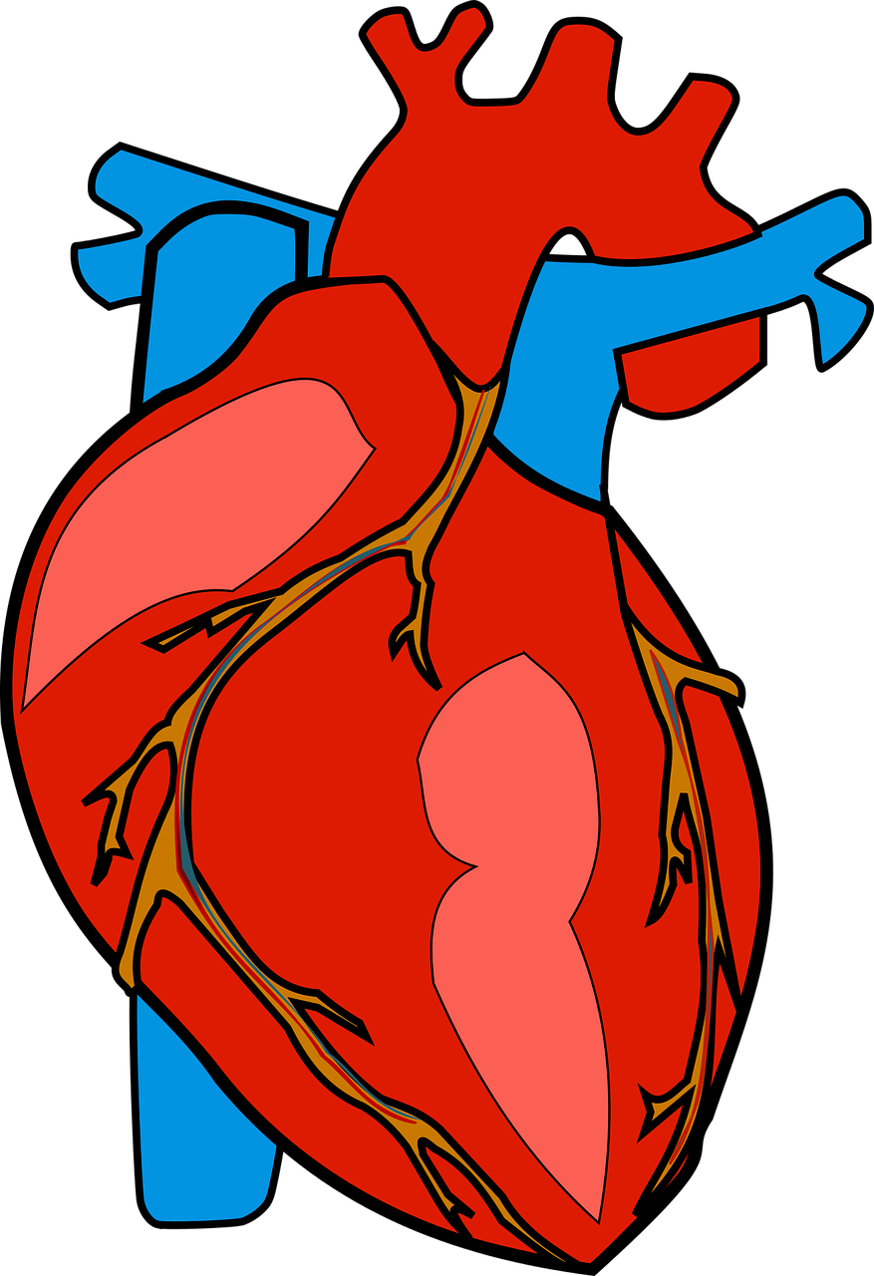
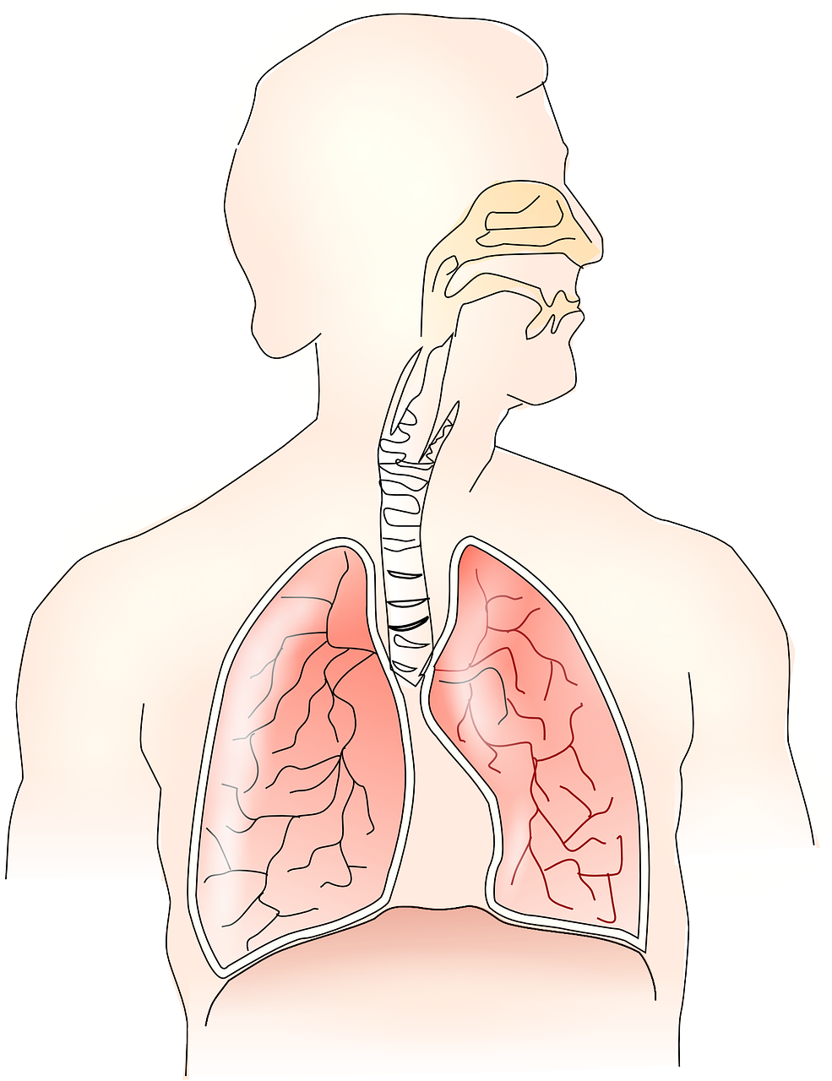
Go to emergency TODAY if you have any of these symptoms postpartum
Chest Pain
Any symptom like fast or irregular heartbeat, pain that moves to your arm or neck, tightness in chest,
Watch out for: sudden onset, swelling, dizziness or confusion, trouble breathing, headache.
This could be a sign of heart attack or a blockage in your lungs

Slide 5

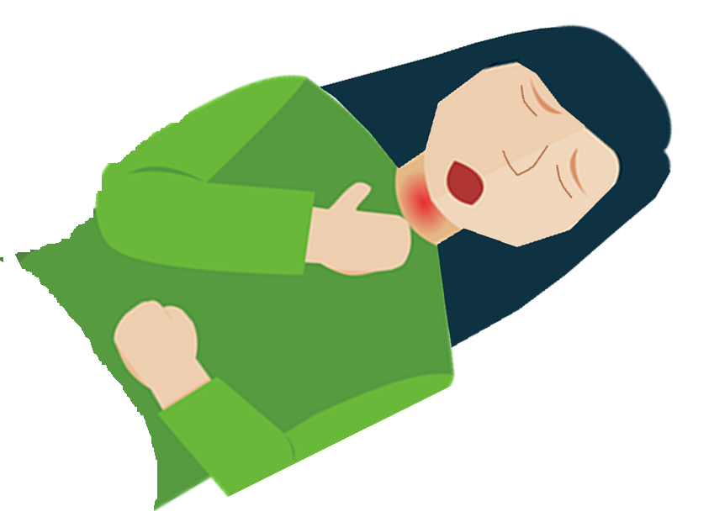
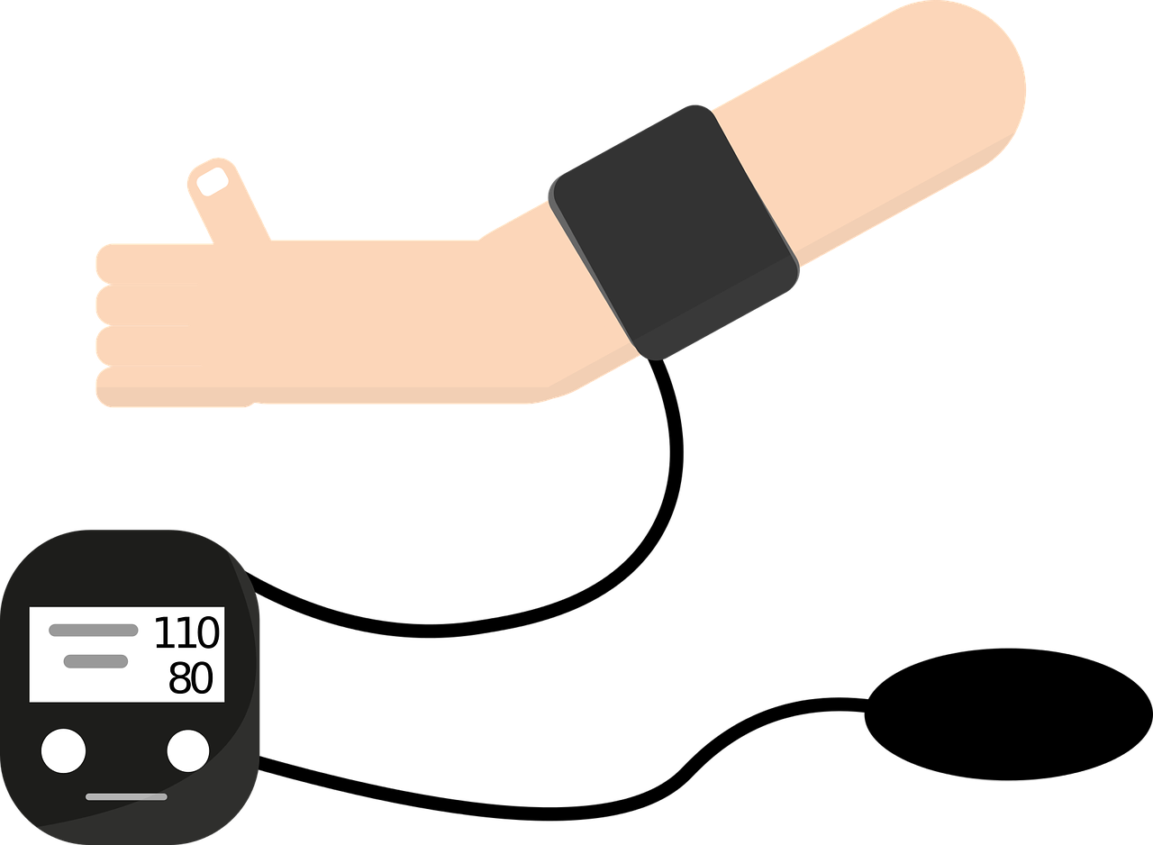

Go to emergency TODAY if you have any of these symptoms postpartum
Trouble Breathing
You can’t get enough air when you breathe, or your chest or throat is tight, or you can’t breathe when you’re lying down
Watch out for: swelling, chest pain, headache, dizziness, changes in vision, or a fast heartbeat
This could be a sign of eclampsia: a medical emergency

Slide 6
Go to emergency TODAY if you have any of these symptoms postpartum
Seizures
You suddenly lose consciousness and have a seizure – your body becomes stiff and shakes and convulses.
This could be a sign of eclampsia: a medical emergency

Slide 7

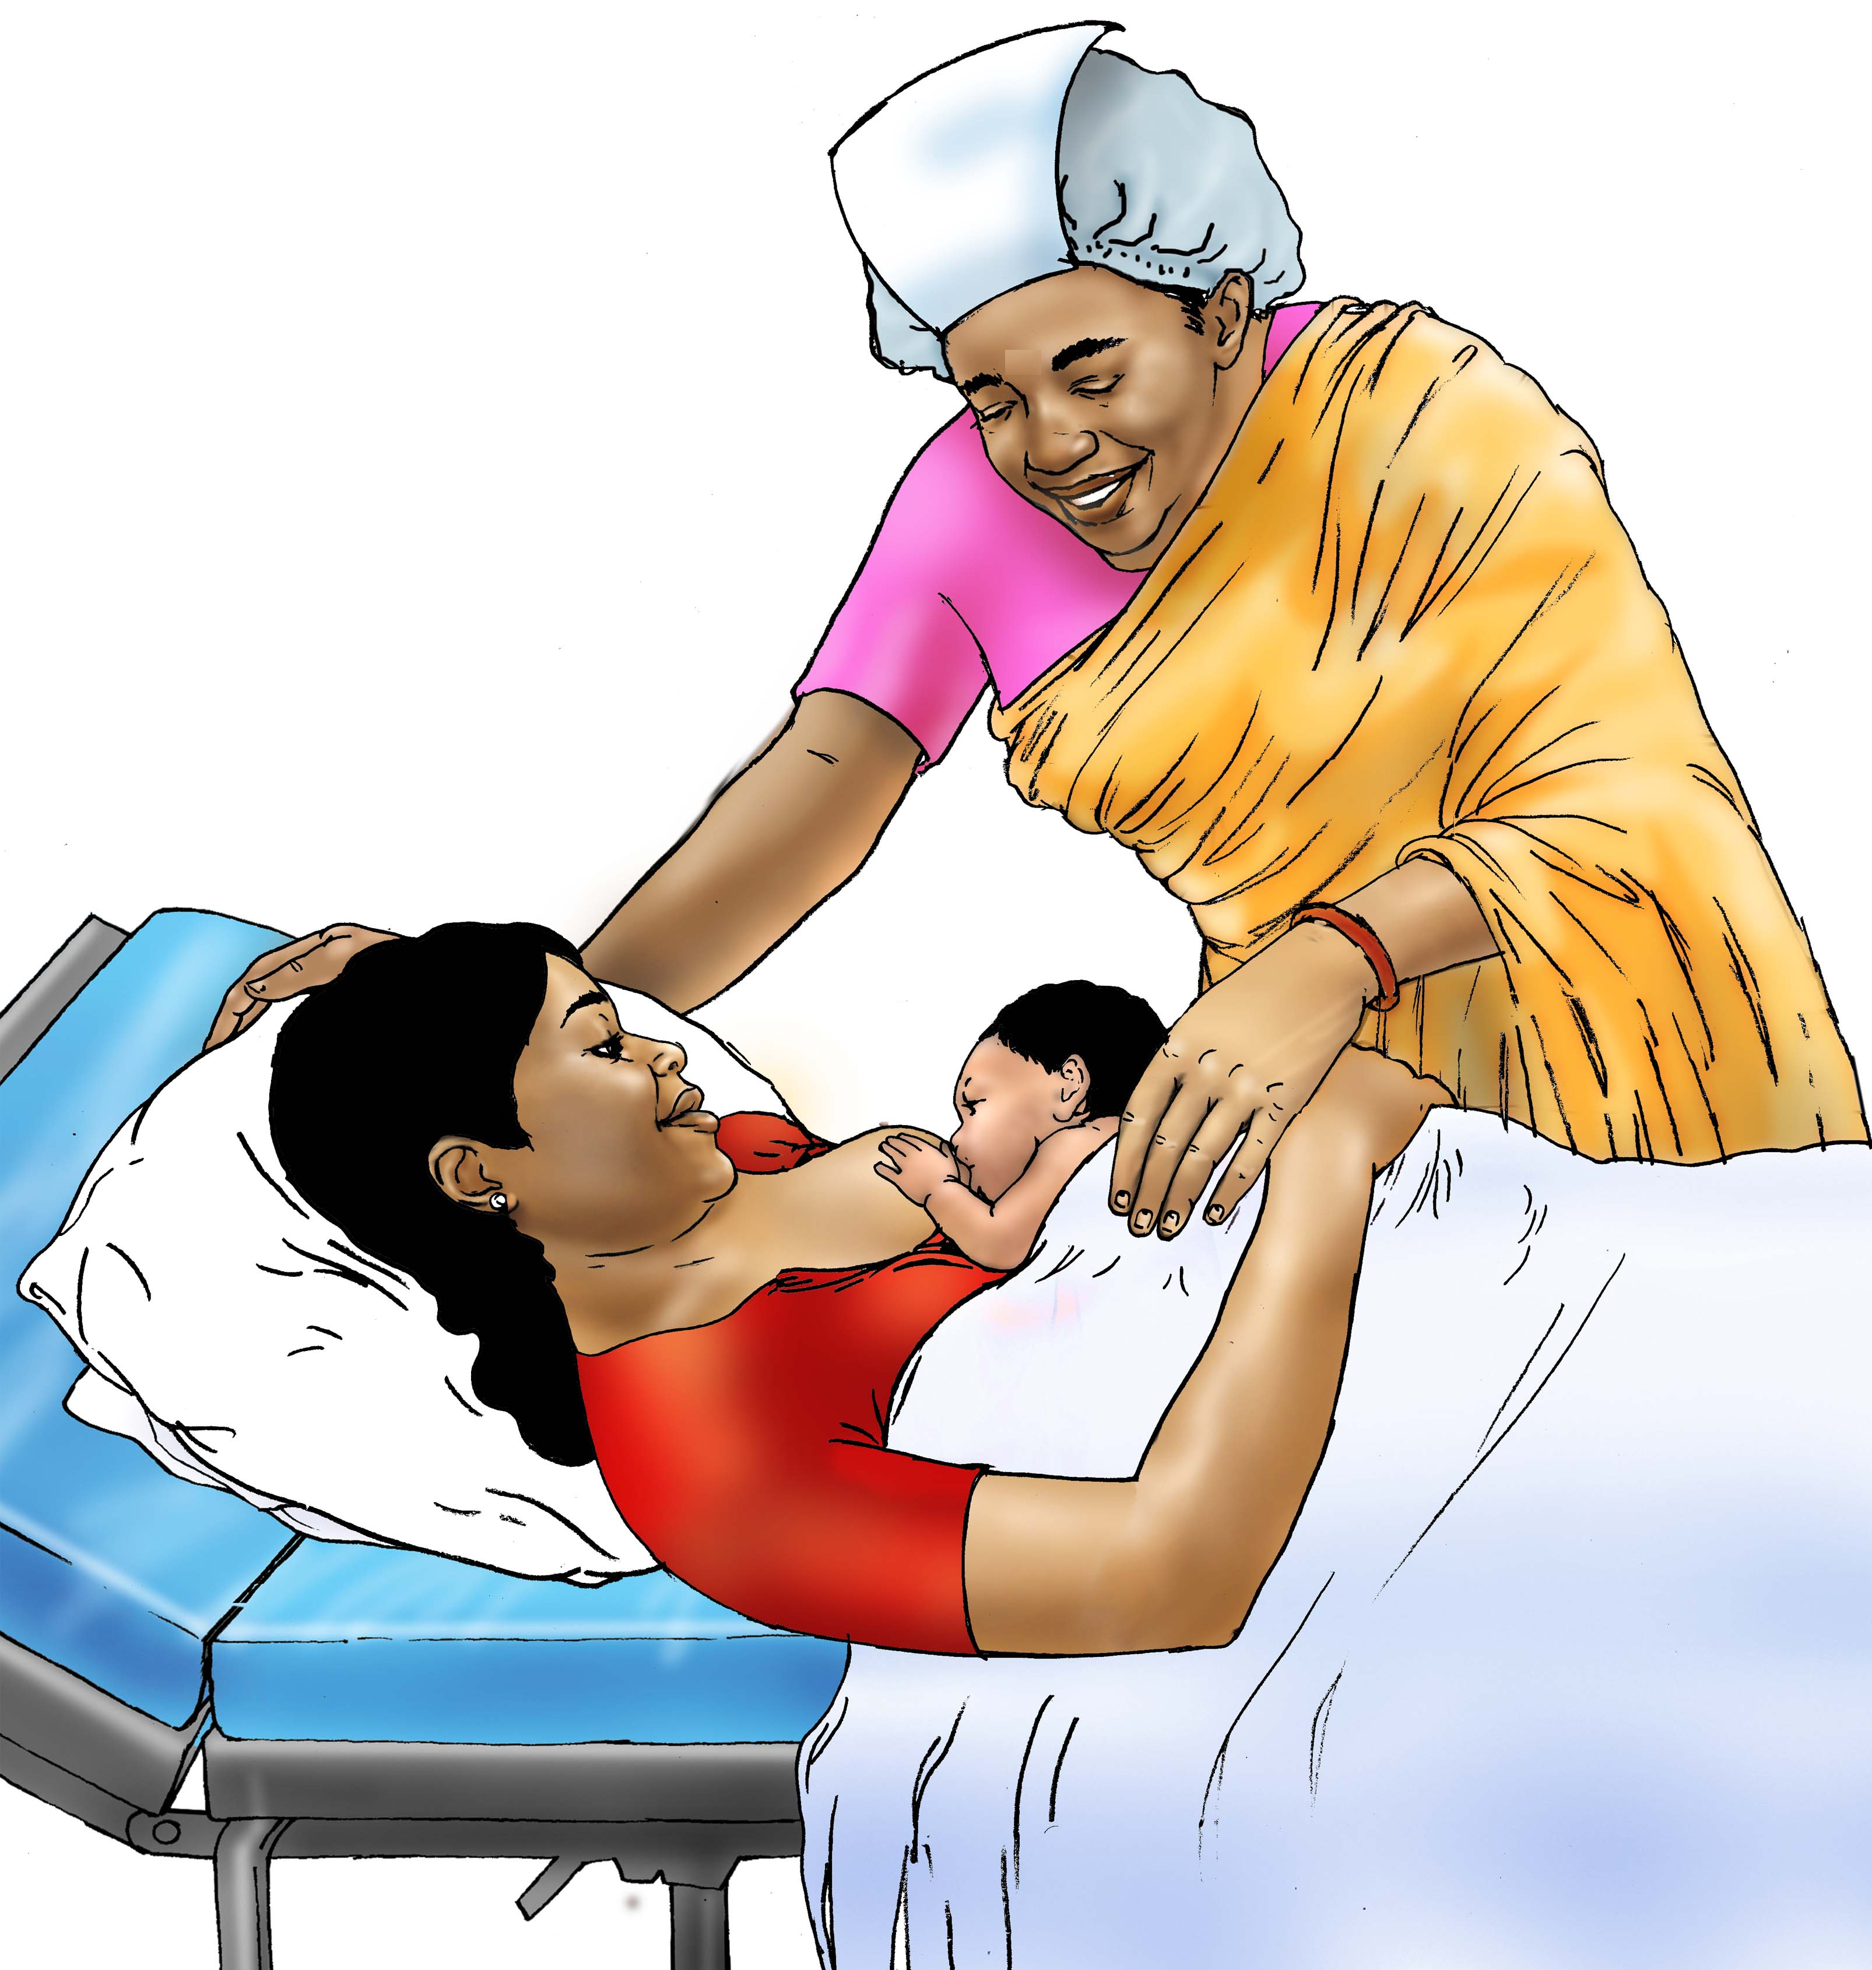
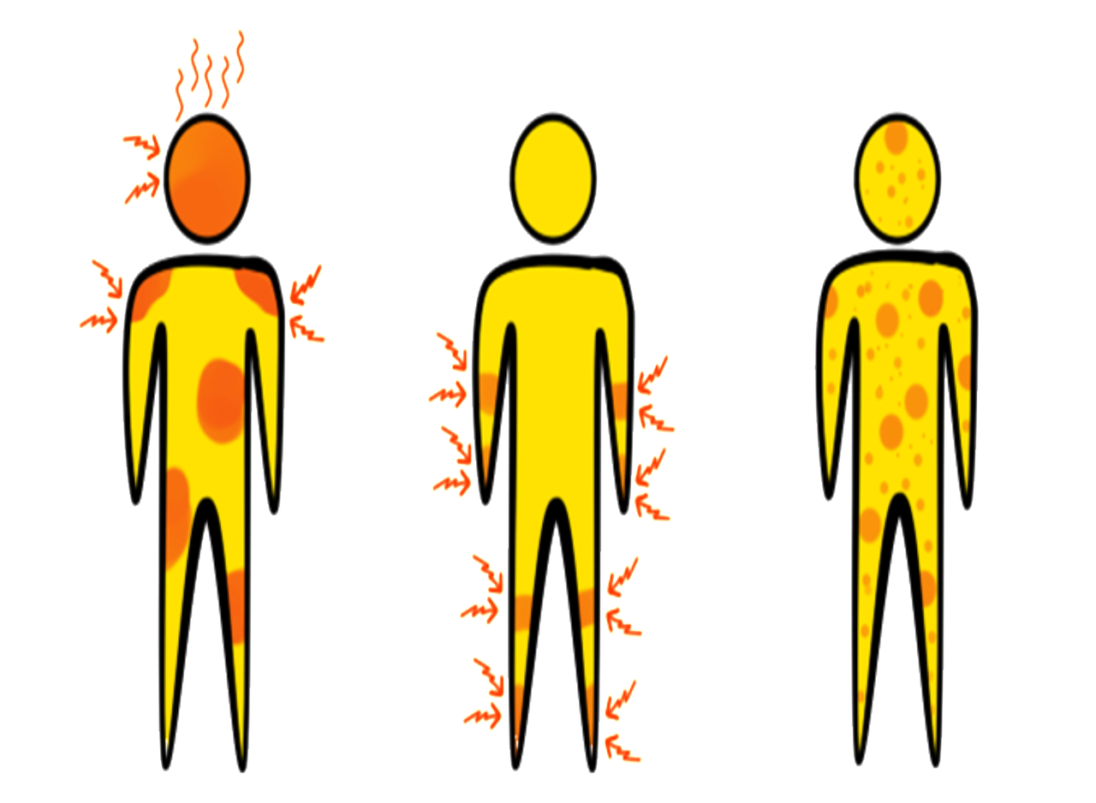
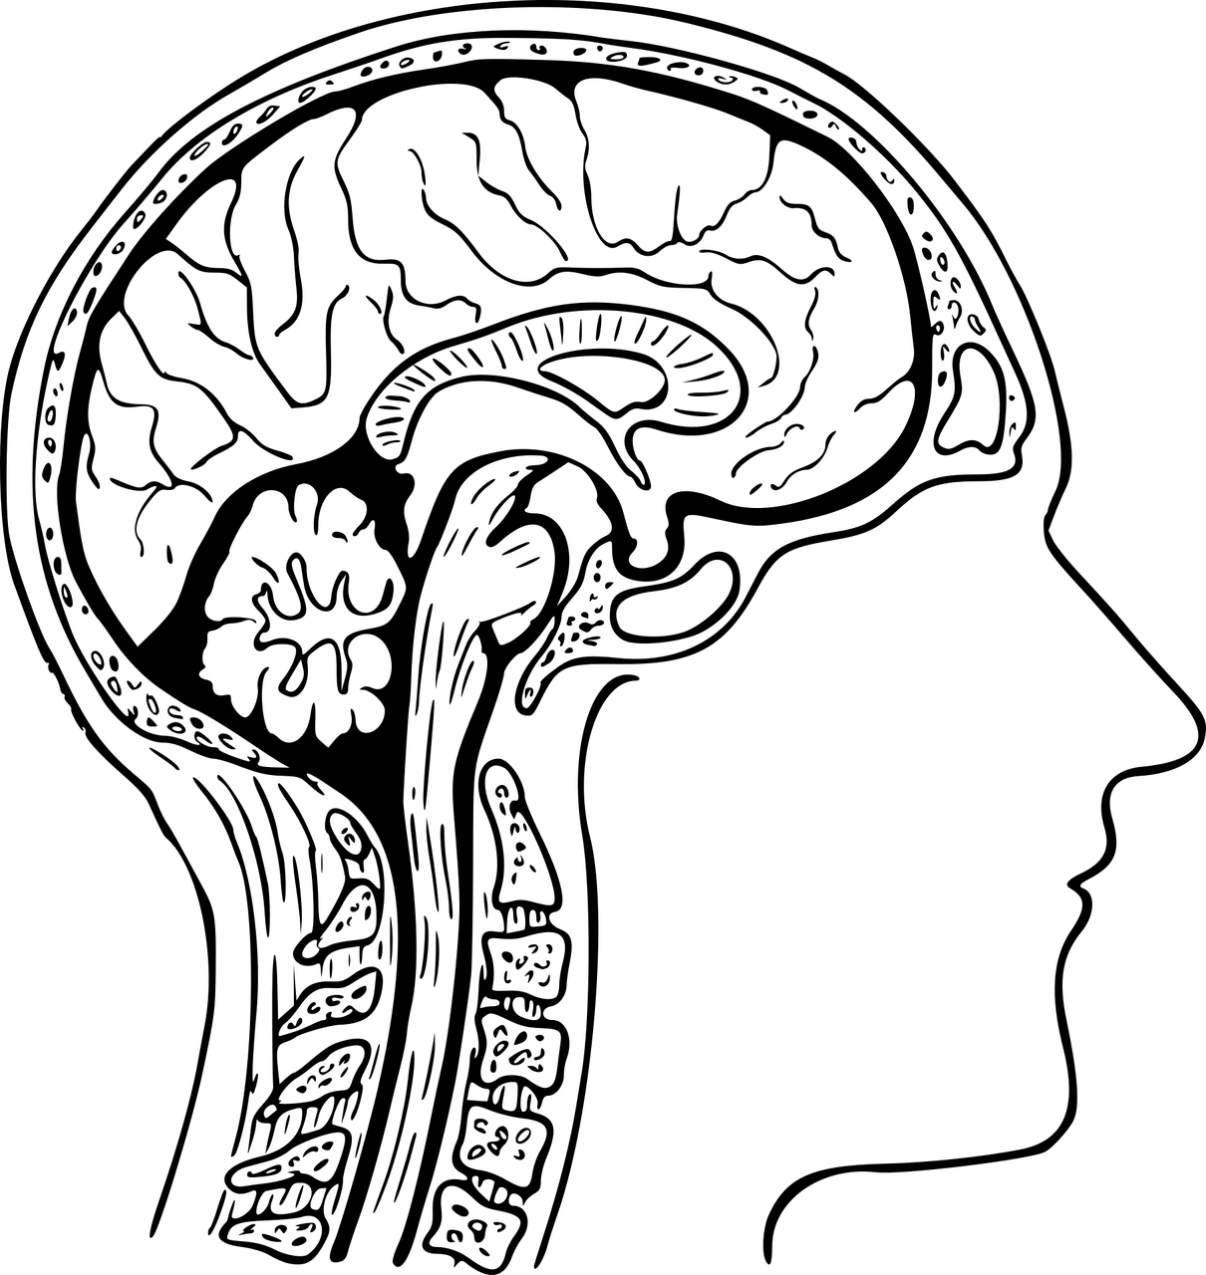
Go to a health center to check for and manage these conditions
Eclampsia
Eclampsia is a very dangerous condition that quickly causes seizures, coma, or death. It usually happens in the 2 days after giving birth.
Women that have pre-eclampsia during pregnancy are at higher risk. They should give birth in a hospital

